Slide 1

BCA Ist Semester Introduction of Logic Circuit and Digital Design(ILCDD) Course Code: BCAC003
Presented by:
Mr.Anuj Kumar
Assistant Professor, Dept. Of CE&A
GLA University, Mathura

Slide 2
Arithmetic operation on Binary numbers
Arithmetic addition
Arithmetic Subtraction

Slide 3
Arithmetic addition
The addition of two numbers in the signed-magnitude system follows the rules of ordinary arithmetic.
If the signs are the same, we add the two magnitudes and give the sum the common sign.
If the signs are different, we subtract the smaller magnitude from the larger and give the difference the sign if the larger magnitude.
The addition of two signed binary numbers with negative numbers represented in signed-2's-complement form is obtained from the addition of the two numbers, including their sign bits.

Slide 4
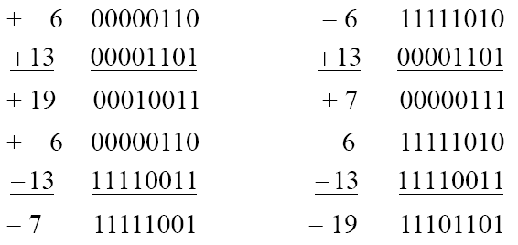
A carry out of the sign-bit position is discarded.
Example:

Slide 5
Arithmetic Subtraction in 2’^{s}-complement
Take the 2’s complement of the subtrahend (including the sign bit) and add it to the minuend (including sign bit).
A carry out of sign-bit position is discarded.

Slide 6
Example:
(− 6) − (− 13)
(11111010 − 11110011)
(11111010 + 00001101)
00000111 (+ 7)

